Slide 1
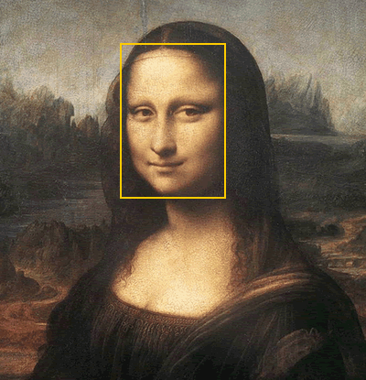
Do you Have the Golden Appeal?↵
By: Victoria & Michael
*Class 703

Slide 2
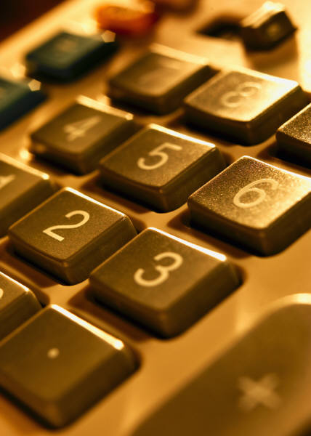
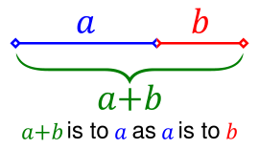
Vocabulary
Golden Ratio: A ratio that is approximately equal to 1.62
Golden Cut: The division of a segment into parts in the ratio of 1.62
Golden Rectangle: Any rectangle with a length to width ratio of approximately 1.62

Slide 3
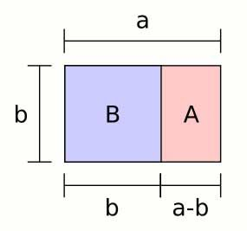
Finding the golden ratio of a rectangle is fairly simple
Golden ratio is 1.61803399, or 1.62
To find the golden ratio of a rectangle you have to multiply 1.62 by the width and you would get the length.
If you want to do the opposite then you divide the length by 1.62 and you would get the width.

Slide 4
Example:
The Mona Lisa's face is
5 inches long & 3 inches wide.
1) You would multiply the
width which is 3 by golden
ratio (1.62) and get approximately the
length which is 5.
2) Then you would divide the length which is 5 by the width which is 3 and get approximately golden ratio (1.62).

Slide 5
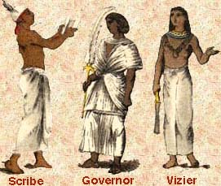
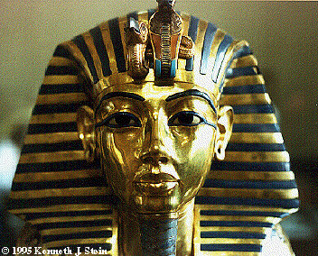
History
Phi is a Greek word for Golden Ratio. Golden Ratio has a bit of a history behind it. Many hundreds of years ago the Egyptians used golden ratio on the tombs. They would see how perfect or not the bottom of tombs were. Golden Ratio is also used in art & architecture. They also see if buildings or paintings have golden rectangles. If they do then that building or painting has a good structure.

Slide 6
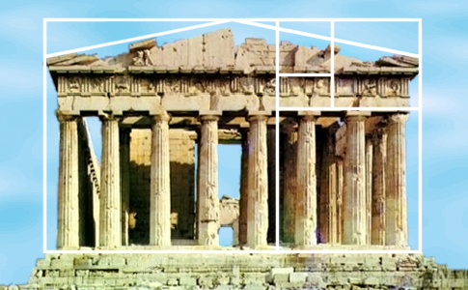
Did you know . . .
When you have a rectangle you can cut off a square and still have a golden rectangle. You can continue cutting off as many squares as you want and they would still be golden rectangles!

Slide 7
Wordsearch!
A | R | E | C | T | A | N | G | L | E
Y | Z | O | H | L | Z | C | B | S | U
F | G | Q | R | A | T | I | O | K | V
P | O | R | K | G | S | W | N | U | L
P | L | E | D | D | E | S | T | A | I
O | D | Z | B | T | H | G | E | G | U
U | E | K | V | J | G | P | X | S | W
I | N | I | D | G | P | Q | D | U | E
N | M | O | N | A | L | I | S | A | Z
M | G | O | L | D | E | N | C | U | T
Word bank:
Mona Lisa
Ratio
Rectangle
Appeal
Golden Cut

Slide 8
Bibliography
http://www.ite.sc.edu/dickey/golden/golden.html
http://mathworld.wolfram.com/GoldenRatio.html
http://mathforum.org/dr.math/faq/faq.golden.ratio.html
Math Advantage Textbook

Slide 9
Do You Have The Golden Appeal?

